Slide 1

Pre-Final Year Presentation on
Application of Automated Visual Inspection of Electric Meter Reading using Traditional Image Processing
By
Piyush Kumar
Roll No. ~ BTECH/10191/21
Under guidance of
Dr. Bikash Kanti Sarkar
Associate Professor,
CSE Dept.
Department of Computer Science and Engineering
Birla Institute of Technology, Mesra
16th July, 2024

Slide 2
Outline of Presentation
Chapter 1 – Introduction
Chapter 2 - Review of Past Work
Chapter 3 - Methodology
Chapter 4 - Results
Chapter 5 - Conclusion and Future Work.
References

Slide 3
Chapter ~1 INTRODUCTION
Motivation:
Why Automated Visual Inspection?
What about Deep Learning?
The traditional manual method of reading electric meters:
are time-consuming and prone to human errors
which results in inaccurate billing and inefficient resource management
and further leads to customer dissatisfaction and revenue loss.
Requires significant manpower and logistical efforts, especially for remote areas
While deep learning models like CNNs, KNNs, and LSTMs are powerful and can handle complex tasks like numeric extraction with high accuracy, they often require significant computational resources and extensive datasets for training. In contrast, traditional image processing techniques are more accessible and can be implemented with less computational power.
The primary reason for choosing traditional methods for this project is to leverage their simplicity and efficiency for numeric extraction tasks.
Classical methods allows for easier debugging and understanding of the process, which is beneficial in a practical, resource-constrained environment. This approach ensures reliable and efficient results without the overhead of training complex models.
Automated visual inspection presents a solution to these challenges improving:
Accuracy: Minimizes billing errors.
Efficiency: Provides rapid, real-time meter readings.
Cost-Effectiveness: Reduces labor costs.
3

Slide 4
Chapter ~ 2 Review of Past Work
2.1 Literature Review
Authors, Year, Journal | Analysis
[1] John Canny , 1986 A Computational Approach to Edge Detection | The Canny edge detection algorithm is a widely used approach that employs a multi-stage process to detect a wide range of edges in images. It is known for its ability to provide good detection, good localization, and minimal response. Techniques like Canny and Sobel filters are common.
[2] R. Gonzalez and R.Woods A Threshold Selection Method | Adaptive thresholding outperforms global thresholding techniques in cases with varying illumination and contrast across the image. OpenCV provides different types of thresholding which is given by the fourth parameter of the function.
[3] Xin-Yi Gong , 2018 An Overview of Contour Detection Approaches | In this paper, the existing contour detection approaches are reviewed and roughly divided into three categories: pixel-based, edge-based, and region-based. In addition, since the traditional contour detection approaches have achieved a high degree of sophistication, the deep convolutional neural networks (DCNNs) have good performance in image recognition, therefore, the DCNNs based contour detection approaches are also covered in this paper.
[4] Mallikarjun Hangarge , 2008 Shape and Morphological Transformation Based Features for Language Identification | Adaptive structuring element design based on local image characteristics, combination of rectangular and elliptical structuring elements to handle text of different orientations and sizes. The proposed approach was evaluated on a dataset of natural scene images with text, showing improved performance compared to traditional morphological techniques and other text extraction methods.

Slide 5
2.2 Existing Techniques
2.2.1 Comparison with Machine Learning-Based Methods
Convolutional Neural Networks (CNNs)
CNNs are highly effective for image classification and recognition tasks. These deep learning models can automatically extract features from image data, making them well-suited for object detection and image segmentation.
However, CNNs often need large annotated datasets and substantial computational power for training and deployment. Their complex architectures and deep learning nature can make them more challenging to implement and optimize compared to traditional image processing methods.
Long Short-Term Memory (LSTMs)
LSTMs are a type of recurrent neural network that are particularly effective for sequence prediction and time-series data analysis. LSTMs have the ability to remember previous inputs, making them more suitable for tasks that require memory of past information.
While LSTMs are not typically used for static image processing tasks, they can be useful for applications that involve processing sequences of images, such as video analysis or time-series data. LSTMs can capture the temporal dependencies in such data, which may not be easily handled by traditional image processing techniques.
K-Nearest Neighbors (KNN)
KNN is a simple and effective machine learning algorithm for classification tasks. KNN works by identifying the K nearest neighbors of a given data point and using their labels to predict the label of the new data point.
While KNN can be a suitable alternative to deep learning methods in certain scenarios, it may not be as efficient for complex image processing tasks that require learning rich feature representations. KNN tends to struggle more with high-dimensional data like images compared to deep learning models.

Slide 6
2.3 Gaps in Existing Literature
Most existing studies focus on either traditional image processing or deep learning-based approaches, with limited work on hybrid techniques that combine the strengths of both .
1. Computational Resource Requirements:
Deep learning methods require significant computational resources, which may not be feasible in all environments. There is a lack of
research on optimizing the computational and memory requirements of automated meter reading systems, crucial for real-world
deployment .
2. Training Data Dependency:
Machine learning models require extensive labeled datasets for training, which can be difficult to obtain. Evaluation of automated meter reading
systems has been primarily done on controlled datasets, with limited testing on diverse, real-world meter images.
3. Complexity and Interpretability:
Traditional methods are simpler and more interpretable compared to deep learning models, which are often considered black boxes.
4. Most existing studies focus on either traditional image processing or deep learning-based approaches, with limited work on
hybrid techniques that combine the strengths of both .

Slide 7
Objectives
Primary Objective
The primary objective of this project is to develop an end-to-end application for automated electric meter reading, leveraging advanced object detection and traditional image processing techniques. This project was initiated based on the existing infrastructure and resources available at SAIL, where electric meters are already installed and readings have historically been recorded manually by laborers and agents. The goal is to minimize costs and labor requirements by automating the reading process.
Specific Objectives:
Object Detection with YOLOv8
Develop and implement a custom-trained YOLOv8 object detection model.
Detect the electric meter in the uploaded image by forming a contour around it.
Numeric Extraction with Traditional Image Processing
Utilize traditional image processing techniques to extract numeric data from the detected electric meter.
Process the uploaded image through various methods such as resizing, color conversion, blurring, edge detection, and contour approximation to accurately identify and extract the numeric information displayed on the meter.

Slide 8
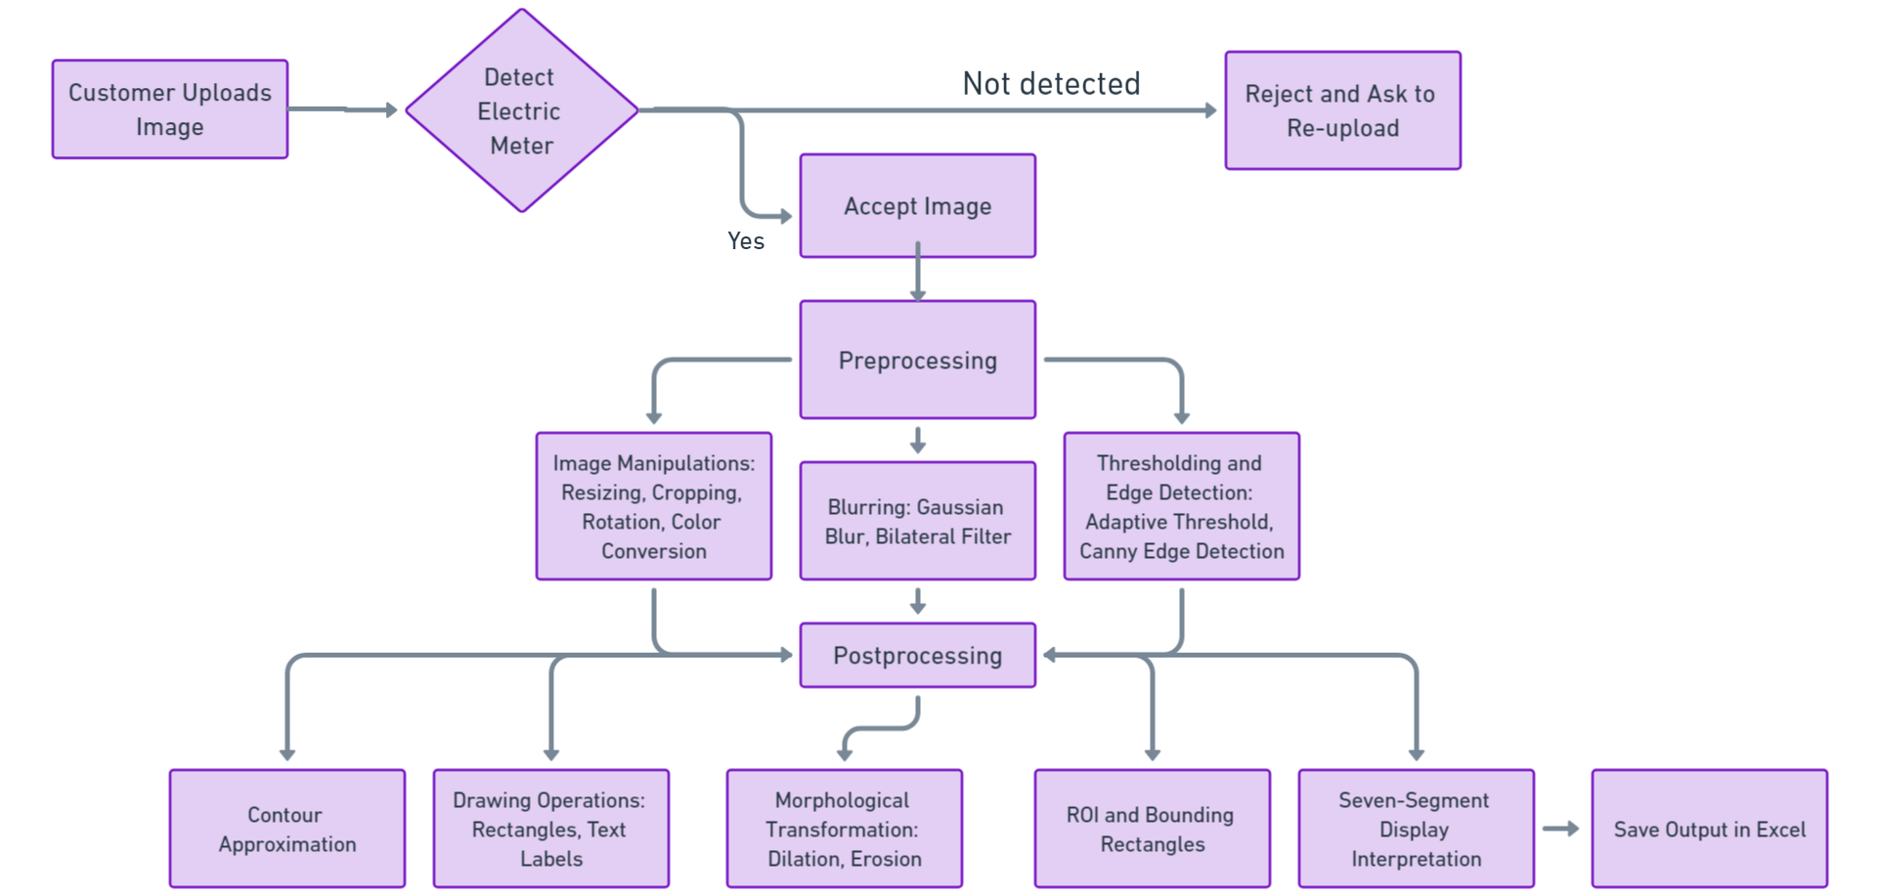
Chapter ~ 3 Methodology
Workflow Overview Diagram:

Slide 9
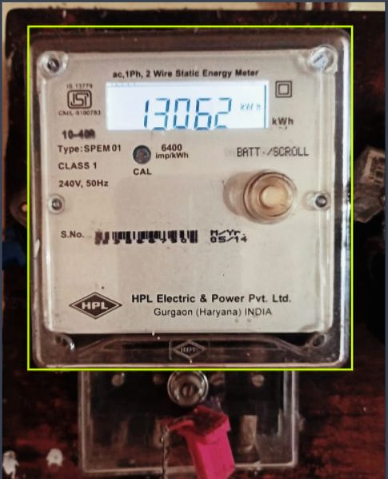
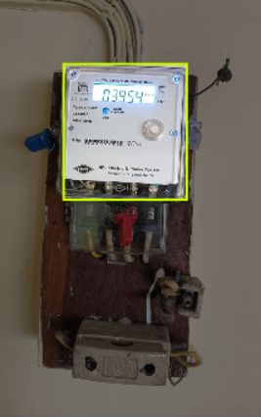
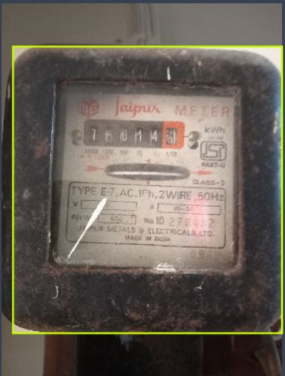
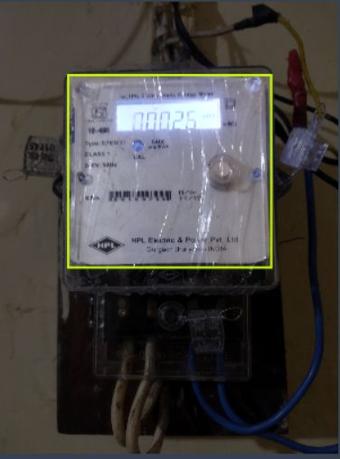
3.2 Meter Detection
YOLOv8 (You Only Look Once Version 8) is a state-of-the-art object detection model known for its efficiency and accuracy. YOLO models are designed to perform real-time object detection, making them suitable for applications where speed is crucial. The YOLOv8 model continues this tradition by incorporating the latest advancements in neural network architecture and optimization techniques.
Example Images of Detection Results

Slide 10
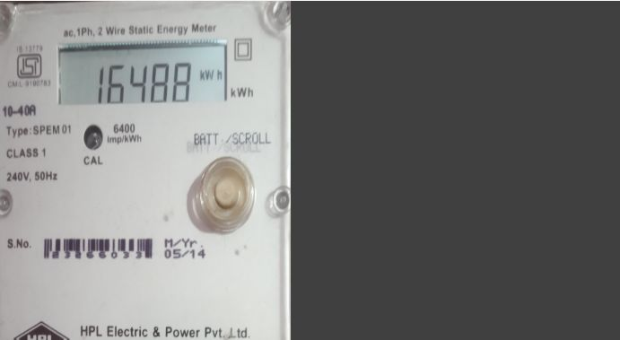

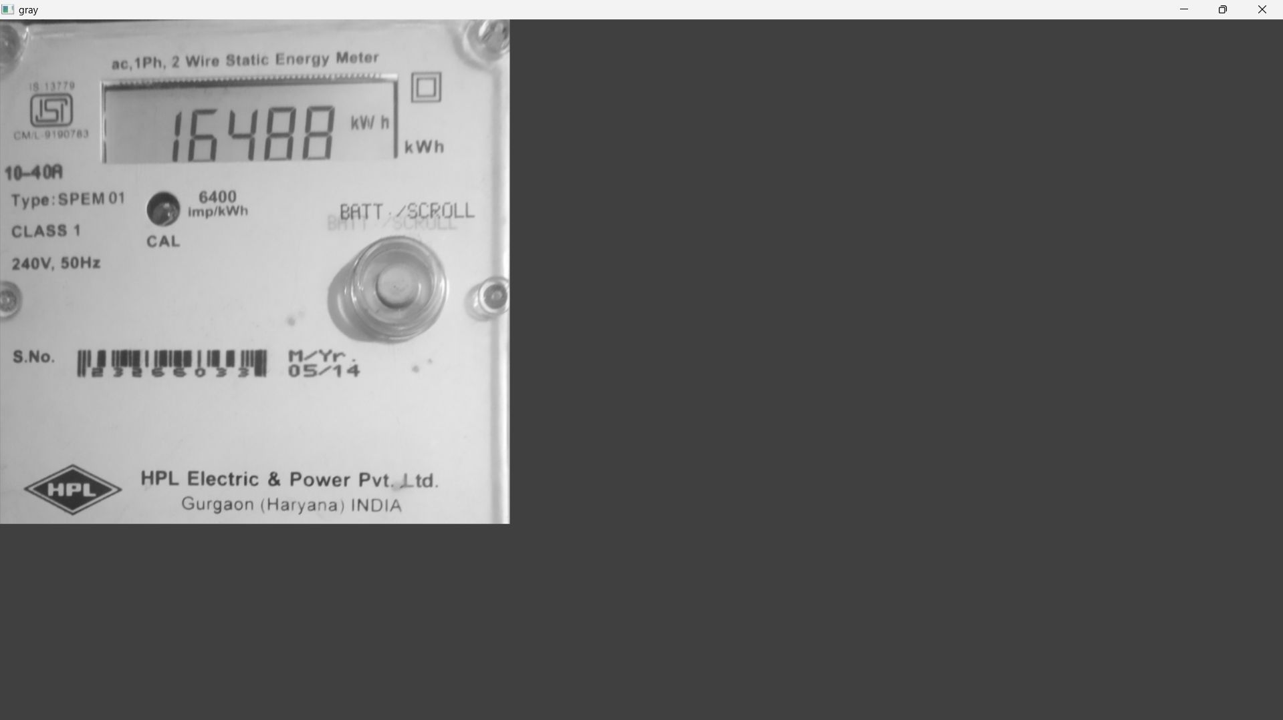
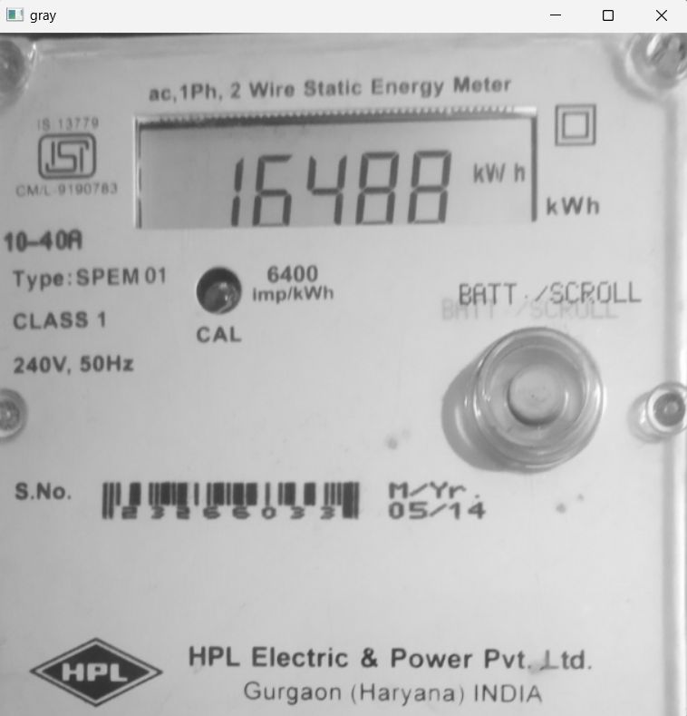
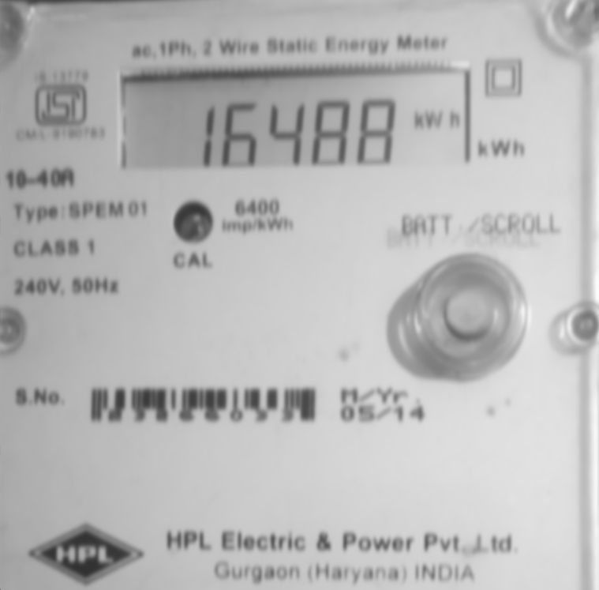
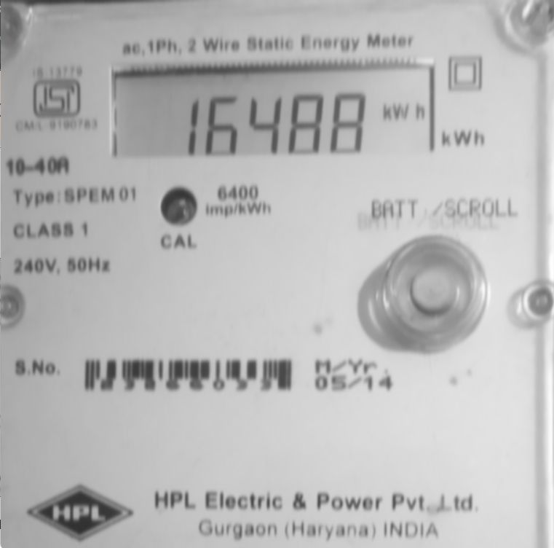
3.3 Preprocessing Techniques
Resizing: Ensures uniform dimensions
Color Conversion: Simplifies analysis by converting to grayscale
Fig. 1.1 – Original Fig. 1.2 – Resized Fig. 1.3 – Grayscaled (does not fit to screen)
Gaussian Blur: Reduces high-frequency
noise.
Bilateral Filter: Preserves edges while
smoothing. Fig. 2.1 Grayscale Image Fig. 2.2 Gaussian blur is applied Fig. 2.3 Bilateral filter is applied

Slide 11
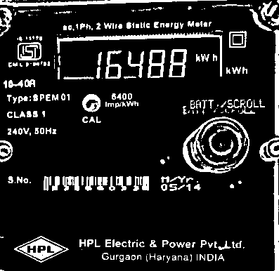
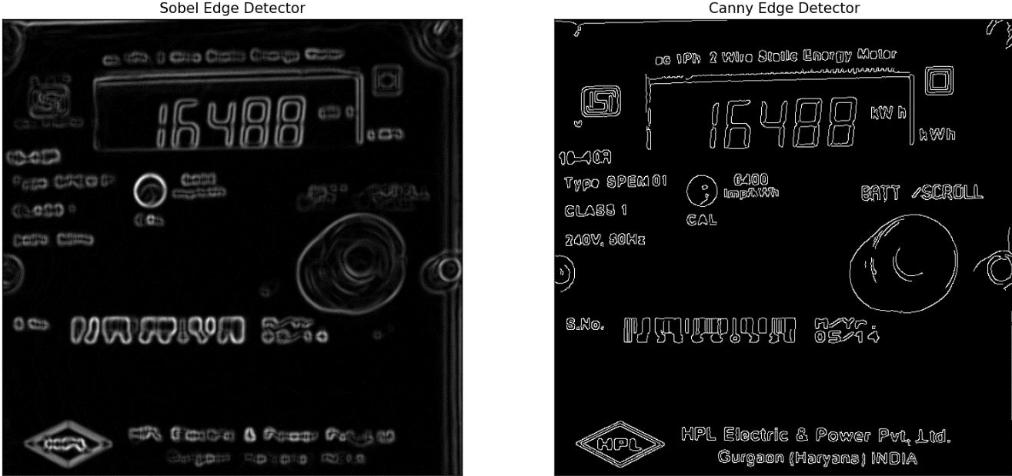
5. Thresholding is a technique used to segment an image by converting it
to a binary image. It helps in distinguishing the foreground from the
background.
6. Edge detection: Two most common used edge detection algorithms are :
Canny Edge Detection - Combines the strengths of edge detection and noise suppression.
It is highly effective in identifying the contours of objects within an image.
2) Sobel Edge Detection – Uses convolution with specific kernels to calculate the gradient
magnitude and direction at each pixel.
Fig. 3.1 Adaptive Thresholding is applied
Fig. 3.2 Sobel and Canny Edge Detection is applied

Slide 12
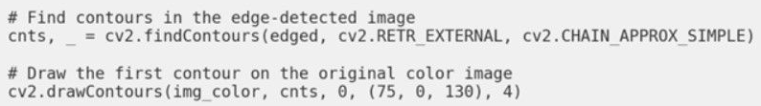
3.3 Post~processing Techniques
3.3.1 Contour Approximation
Contours are the boundaries of objects within an image. Identifying and approximating these contours is essential for tasks like object detection and recognition.
Find Contours: Identifies boundaries within the image
Draw Contours: Visualizes the detected contours
3.3.2 Region of Interest (ROI)
When diving into the world of digit recognition, many introductory deep learning courses use the well-known MNIST database. This dataset, which consists of handwritten digits, has become a staple in machine learning projects.
However, for a beginner computer vision developer, exploring real-life images introduce challenges that curated databases like MNIST do not.
These images are often noisy, with different backgrounds, lighting conditions, sizes, shapes, and colors of the meters.
ROI selection can be done manually by the user or automatically based on the output of previous processing steps, such as object detection or segmentation.

Slide 13
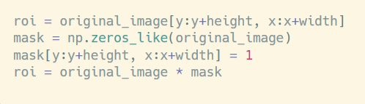
3.3.2.1 ROI Selection
There are a few common ways to select an ROI:
Manual Selection: The user manually selects the ROI by drawing a bounding box, polygon, or other shape around the area of interest using a graphical user interface (GUI) or programming tools.
Automatic Selection: The ROI is automatically detected and selected based on the output of previous processing steps, such as object detection, edge detection, or image segmentation.
Predefined ROI: The ROI is predetermined based on the application or the known location of the object of interest in the image.
3.3.2.1 ROI Extraction
The basic steps for ROI extraction are:
Obtain the Coordinates: Determine the coordinates (e.g., x, y, width, height) of the selected ROI.
Crop the Image: Use the ROI coordinates to crop the original image and extract only the selected region.
python
3. Apply a Mask: Alternatively, you can create a binary mask that is the same size as the original image, with 1s (white) in the
ROI and 0s (black) elsewhere. Then, you can apply this mask to the original image to extract the ROI.

Slide 14
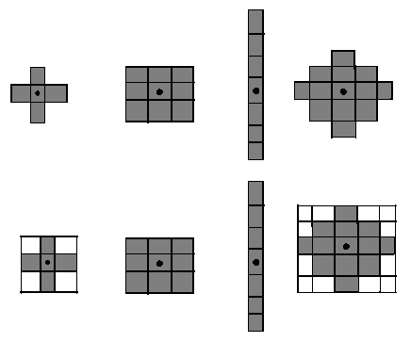
Morphological Transformations
Erosion : Erosion reduces the boundaries of foreground
objects by sliding a kernel over the image and setting a pixel
to 1 only if all the pixels under the kernel are 1.
Dilation : It is the opposite of erosion. It sets a pixel to 1
if at least one pixel under the kernel is 1, effectively
expanding the foreground objects.
Opening and Closing: Another name for Erosion, followed by
Dilation is the Opening. It is useful in removing noise in our image. The reverse of Opening is Closing, where we first
perform Dilation followed by Erosion, particularly suited for closing small holes inside foreground objects.

Slide 15

Seven-Segment Display
A seven-segment display is a common electronic display format used for showing digits. Each digit is represented by a combination of segments (a-g) that can be turned on or off. In image processing, recognizing a seven-segment display involves detecting these segments and determining which ones are active.
For each digit, we examine the pixel values in each of the seven
segments. If the majority of pixels in a segment are white, we
classify that segment as being activated (state of 1); otherwise,
it is deactivated (state of 0). After evaluating all seven segments, we
form a binary array representing the digit, which we use to look up
the corresponding value in our dictionary.

Slide 16
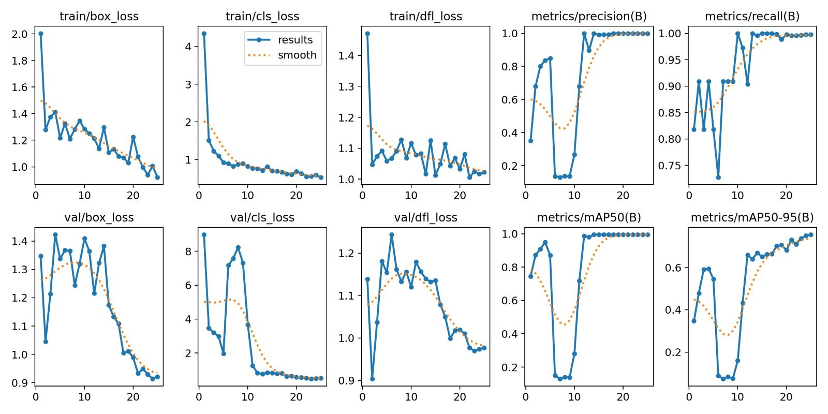
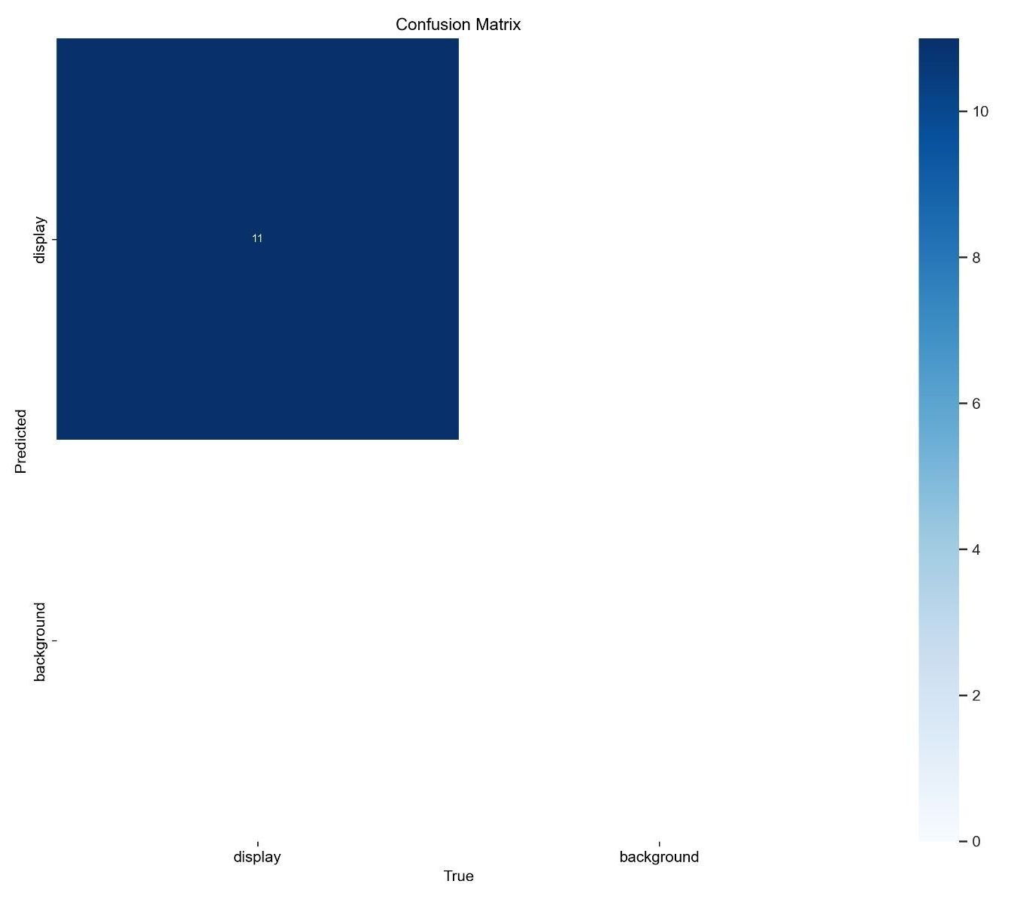
Chapter ~ 4 Results and Discussion
The custom-trained YOLOv8 model achieved high accuracy in detecting electric meters in user-uploaded images, demonstrating its effectiveness and robustness. The integration of traditional image processing techniques for numeric extraction further enhanced the system's reliability. Below is the.
Confusion Matrix
Training and Validation Metrics recorded

Slide 17
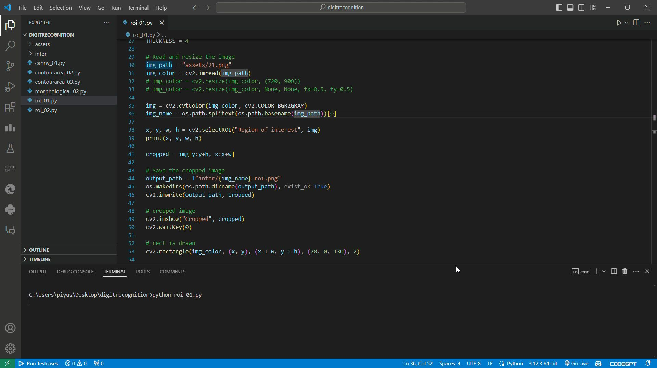
Manual ROI Selection and Extraction

Slide 18
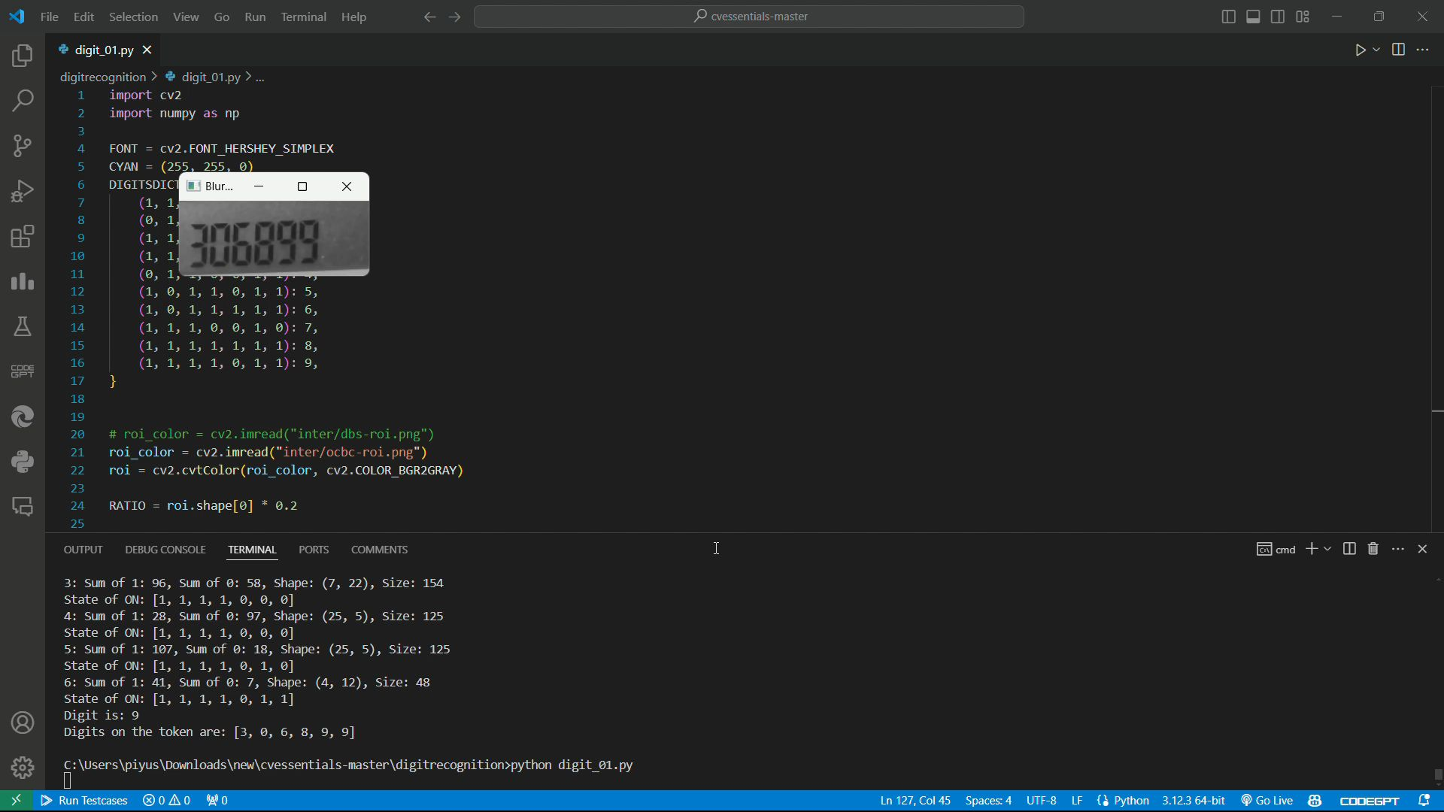
Working of Seven Segment Display

Slide 19
Chapter ~ 5 CONCLUSION
The project achieved its goal of developing an end-to-end application for automated electric meter reading. By leveraging YOLOv8 and traditional image processing techniques, the system provided an efficient, accurate, and scalable solution for meter reading. The success of this project lays the groundwork for future enhancements and potential integration with more advanced machine learning models.
Learning Outcomes:
Gained hands-on experience with YOLOv8 and its application in object detection.
Enhanced understanding of traditional image processing techniques and their practical applications.
Developed skills in web application development using the Django framework.
Personal Experience:
The project provided valuable insights into the challenges and solutions associated with automated meter reading. The integration of various technologies and techniques offered a comprehensive learning experience, reinforcing the importance of interdisciplinary knowledge in solving real-world problems.

Slide 20
FUTURE WORK
Implementation of Smart Meters:
Objective: Transition from traditional electric meters to smart meters.
Details: Smart meters can automatically record and transmit meter readings to the utility company, eliminating the need for manual readings. The implementation of smart meters would involve replacing existing meters with smart ones and setting up a communication infrastructure to collect and process the data.
Use of QR Codes for Each Meter:
Objective: Enhance the accuracy and efficiency of the meter reading process by incorporating QR codes.
Details: Assigning a unique QR code to each meter allows for quick and accurate identification. When a user uploads an image, the system can scan the QR code to instantly recognize the meter and associate it with the correct account.
Acquisition of Licensed Software Solutions:
Objective: Improve the meter reading process by leveraging existing, proven software solutions.
Details: Purchasing and deploying licensed software designed for automated meter reading can offer a quick and reliable solution. These software solutions typically come with advanced features, support, and regular updates, ensuring high performance and accuracy.

Slide 21
References
[1] J. Canny , “A Computational Approach to Edge Detection.” , 1986
[2] R. Gonzalez and R.Woods “A Threshold Selection Method”
[3] Xin-Yi Gong , “An Overview of Contour Detection Approaches”, 2018
[4] M. Hangarge , “Shape and Morphological Transformation Based Features for Language Identification”, 2008
[5] W. Lin , Z. Zhao , J. Tao, C. Lian and C. Zhang , “Research on Digital Meter Reading Method of Inspection Robot
Based on Deep Learning”, 2013
[6] Xianghui Liu; Yancong Deng; Yingkai Sun; Yuting Zhou , 2019 “Multi-Digit Recognition with Convolutional Neural Network and Long Short-Term Memory”
[7] OSSpk , “A Comparative Study on Handwritten Digits Recognition using Classifiers like K-NN, Multiclass Perceptron and SVM”, 2018
[8] Li Deng and Dong Yu, “Deep Learning: Methods and Applications," Foundations and Trends in Signal Processing, 2014.
[9] A. Krizhevsky, I. Sutskever, and G. E. Hinton, “ImageNet Classification with Deep Convolutional Neural Networks," Advances in Neural Information Processing Systems, 2012.”
[10] C. Olah, “Understanding LSTM Networks,” 2015.
[11] OpenCV: Morphological Transformations
[12] Seven-segment Display

